Slide 1
NPL Project
Topic: Collaborative Editor.
Team Members:
Name | Roll No
Shaikh Asif | 1130352
Shaikh Afjal | 1130348
Shaikh Shuaib | 1130354

Slide 2
Introduction
Technology: JAVA
The famous java programming language provides networking through socket connection with which the chat application like application can be made. UI is needed to make for such application. UI is also provided by the Swing class of javax package. So with the knowledge of both the classes and effort to make can result into an application which is intended.
KeyListener is the interface in java provides keyPressed() method with which whenever user types anything we send it to other connected application with this over socket connection. When other application receives the message then print immediately into its text area

Slide 3
Two components in our application are below:
Labels: It is used to display a message to user of the application about other component in the container (like textarea).
TextArea: Two textareas used are as follows:
1. It is used to show the list of persons connected over socket network.
2. It is used for transfering of message within connected device in real time.
First Server needs to be start, then Client. There are two java files Server and Client. When Server.java runs, it takes name and displays the editor with its name.

Slide 4
When Client runs, it takes the name for the same purpose as for server then takes the IP address of the computer in which the Server.java is running to establish connection. Once connection name of each other’s will be shown in the text area which is labeled as list of persons connected. Now both are ready to edit together or one can wait and watch while other is typing.

Slide 5
Scope of the project:
To make the software which two person can edit together at the same time.
To makie a user friendly environment for users for collaborative editing.
With this the two people who want to work on the same document together and they both are at much distance away from each other.
In such case, this type of application may fulfill their needs.

Slide 6
Project
What is the project?
The project is ‘Collaborative Editor’ with which two people can simultaneously edit the same document or can edit the same code/program at the same time from a large distance with the help of socket connection it is made possible.
This project connects the two person for editing or doing work together and it is not possible because they are not in the same place and they don’t want to meet due to any reason.

Slide 7
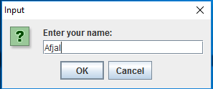
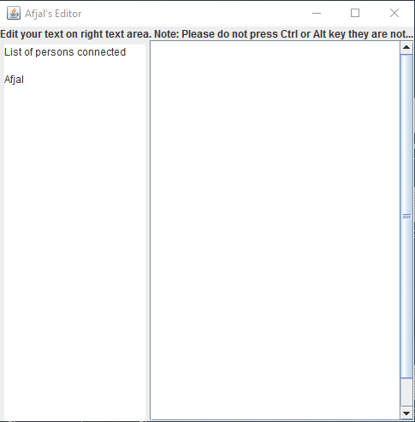
User Interface:
Server

Slide 8
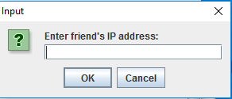
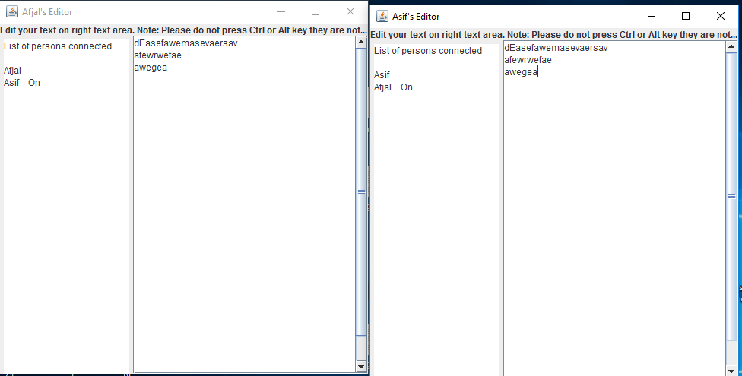
Client Side
Server Client

Slide 9
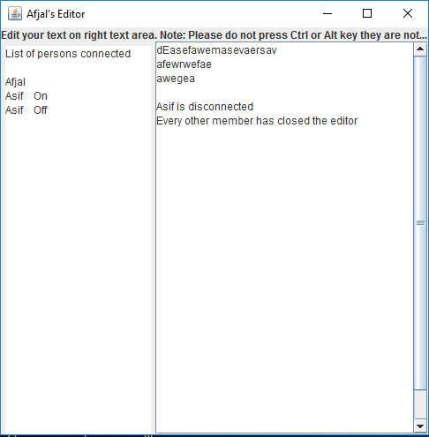
Client has closed and the message of disconnection is shown to server . Similarly this will be shown to client in case if server has closed.
Server Container/Frame

Slide 10
Future
This software can be updated. It is the basic real time editing software. To impart more features to the software other things can be done like below:
10 user can edit together
Provide saving of document which is edited.
Give them a platform for chatting so that they can make or edit their work by consent of each other. Without any misunderstanding what other is doing. Communication take place which can understand their work more clearly.

Slide 11
Works in this technology
The idea to do this project came from the website collabedit.com which give access to innumerable people to connect and edit together. This is little like chatting but here instead of send button pressing when key presses from the keyboard data gets transfer and displays on other side.

Slide 12


